Slide 1
UH-Fluor Industrial Conference Construction-Driven Execution
Health Safety and Environmental Topic

Slide 2
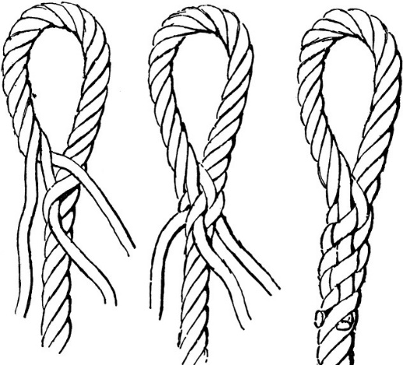
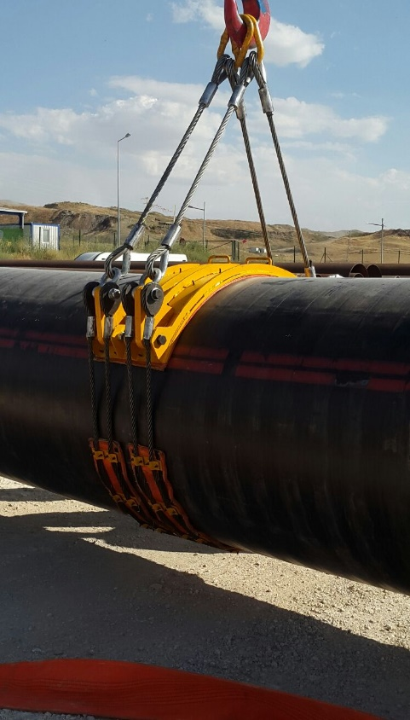
The Implementation of Spliced Steel Slings for Hoisting
Common Component used with pipe belts
Slings are typically braided and crimped
As forces are applied the splice tightens
Reduces risk of swing and complete overhead load failure
Improves safety for workers, material, and environment

